Slide 1
Next shot prediction-MoViNets
2018150402 김유리

Slide 2
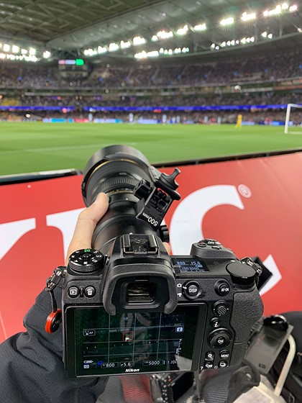
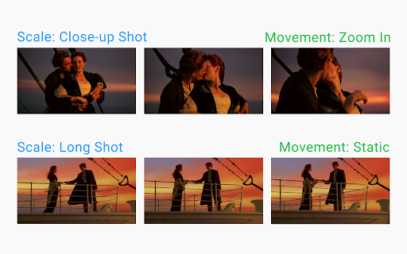
VIDEO
Soccer
MovieNet

Slide 3
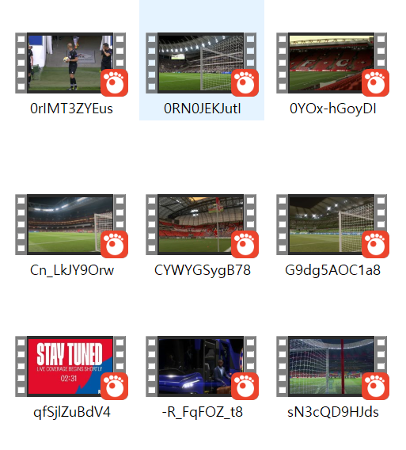
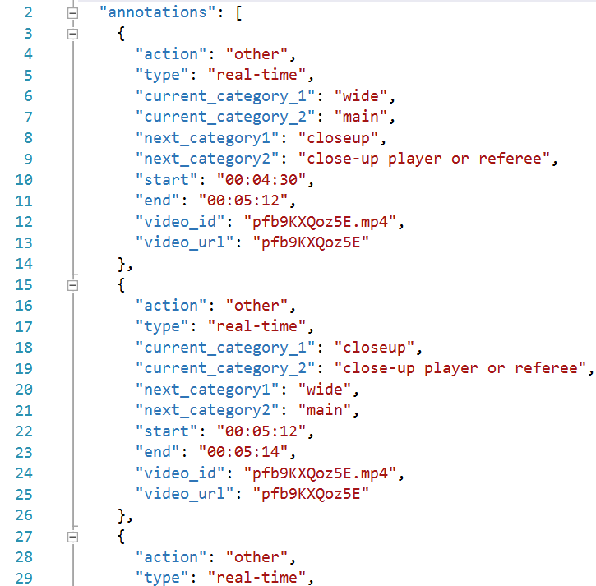
DATASET
- Annotation
Soccer game videos
annotation

Slide 4
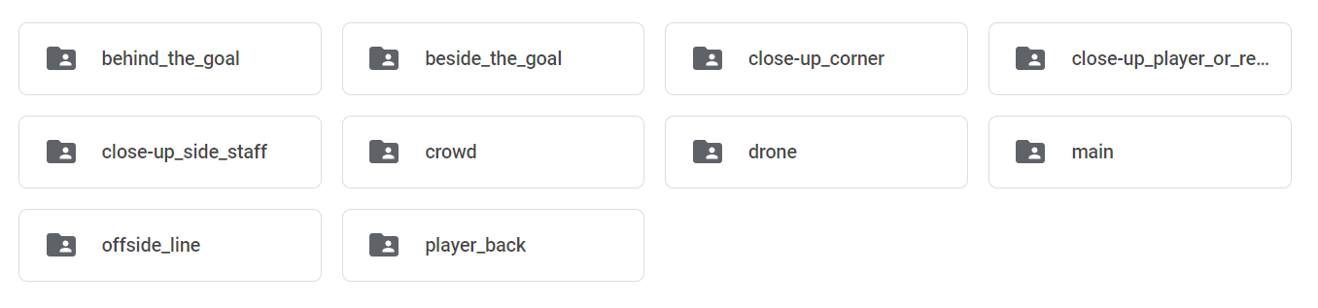
DATASET
- Annotation
0 1 2 3
4 5 6 7
8 9

Slide 5
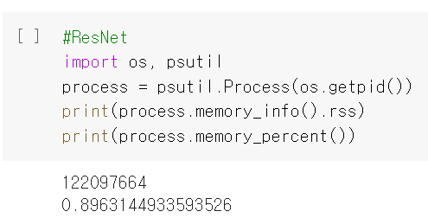
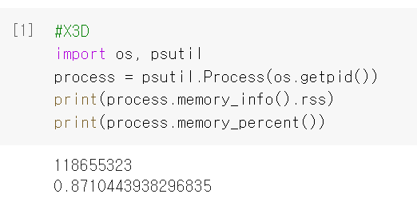
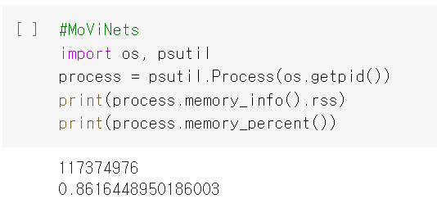
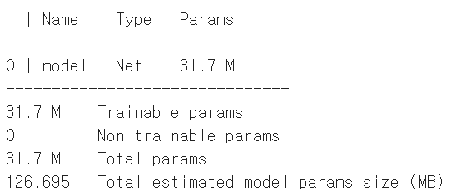
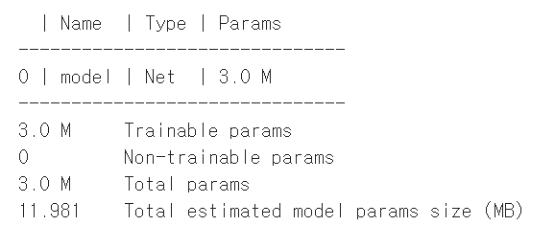
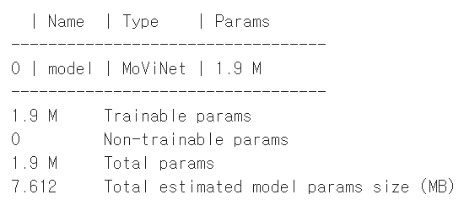
Models
ResNet
X3D
MoViNets

Slide 6
Next Shot Category
52.9%
50.4%
54.4%
ResNet
X3D
MoViNets
Resnet for video recognition with BatchNorm3d and ReLU activation
expand a tiny 2D image classification architecture along multiple network axes
memory efficient video network that can operate on streaming video for online inference

Slide 7
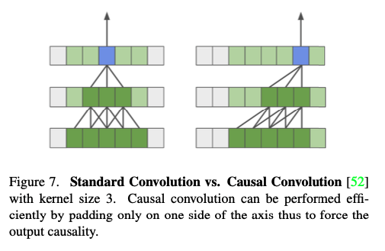
Causal Conv
Causality
The receptive field of a stack of 1D convolutions only extends to features up to the current time step
Unidirectional along the temporal dimension

Slide 8
보완할 점
Room to improve model
02
Data augmentation & transform
04
Improve/Replace CausalConv
01
03
Other categories as input
Collect more data

Slide 9
Thank You

